Slide 1


AI Bot for Snake Game
TEAM MEMBERS
SHASHANK MYLAVARAPU
00809780- SMYLA3@UNH.NEWHAVEN.EDU
NANDAKI KARNATI
00810803- NKARN3@UNH.NEWHAVEN.EDU
TEJASWINI SERU
00791018– TSERU1@UNH.NEWHAVEN.EDU

Slide 2


Contents
Approach
Methodology
Flow of Execution
Execution
Evaluation
Demo

Slide 3
Reinforcement learning
Approach
Reinforcement learning is a machine learning training method based on rewarding desired behaviors and/or punishing undesired ones. In general, a reinforcement learning agent is able to perceive and interpret its environment, take actions and learn through trial and error.
Applications of RL:
Game AI
Robotics
Autonomous vehicles
Recommendation systems

Slide 4
Methodology
In this project we are training AI Snake Bot using qlearning algorithm which generates a q table. This table is used by the snake bot to play itself automatically.
1. Train the Bot: Define all the hyper parameters and continue the game until the game is over by predicting the next state of food and the Bot.
2. Q table : Once the training is done a q table is generated which is used by the Bot to play the game itself.
3. Algorithm : In this we used Q learning algorithm for the training of the Bot.
Q-learning is a reinforcement learning method that teaches a learning agent how to perform a task by rewarding good behavior and punishing bad behavior. In Snake, for example, moving closer to the food is good. Going off the screen is bad. At each point in the game, the agent will choose the action with the highest expected reward.

Slide 5
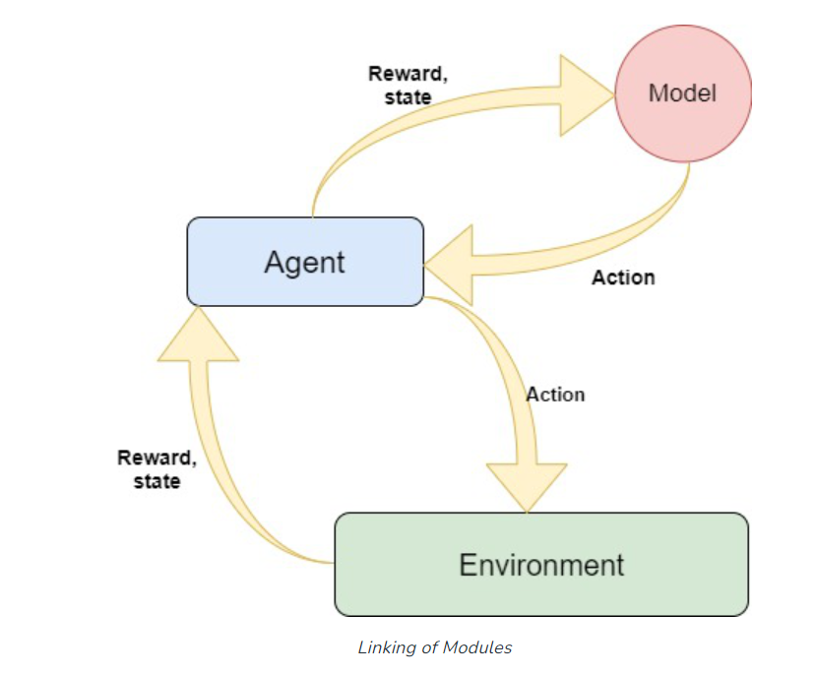
Qlearning Algorithm

Slide 6
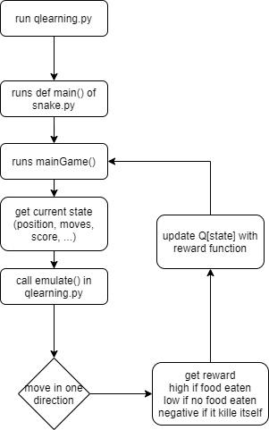
Flow of Execution

Slide 7
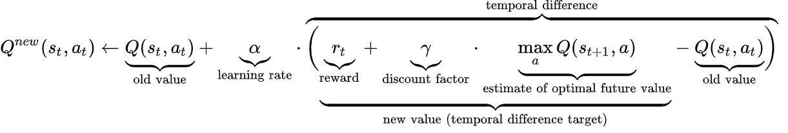
Execution
Provide the configuration (State space, Action space (already included in the qlearining.py file))
Fix the mode training and Playing by using “t” and “p”
Trian the snake bot by running the following command using the command prompt or the terminal of the any IDE.
"python qlearning.py t“
Formula used:
Play the game
"python qlearning.py p "

Slide 8
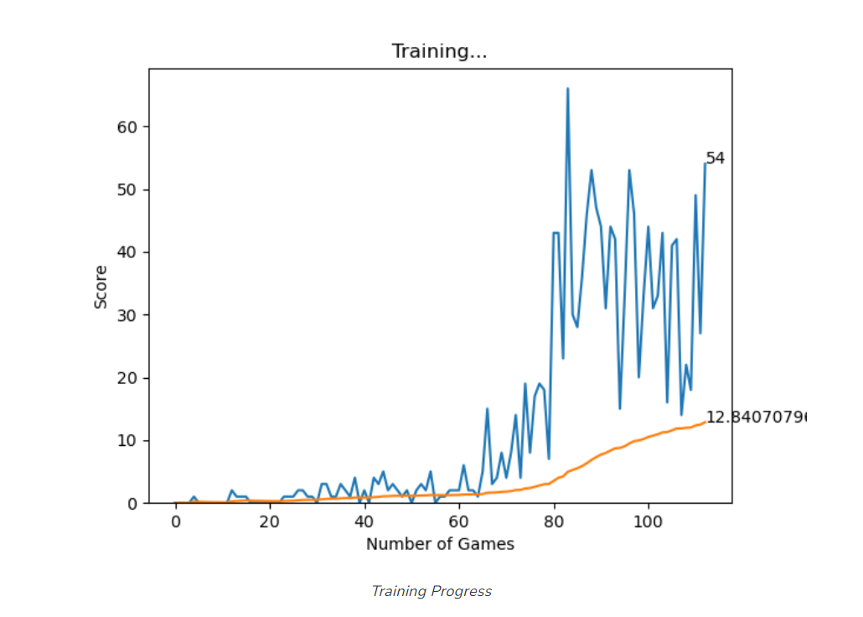
Evaluation
The total rewards per episode increased as we increase the number of episodes in training which is shown in the graph below.

Slide 9
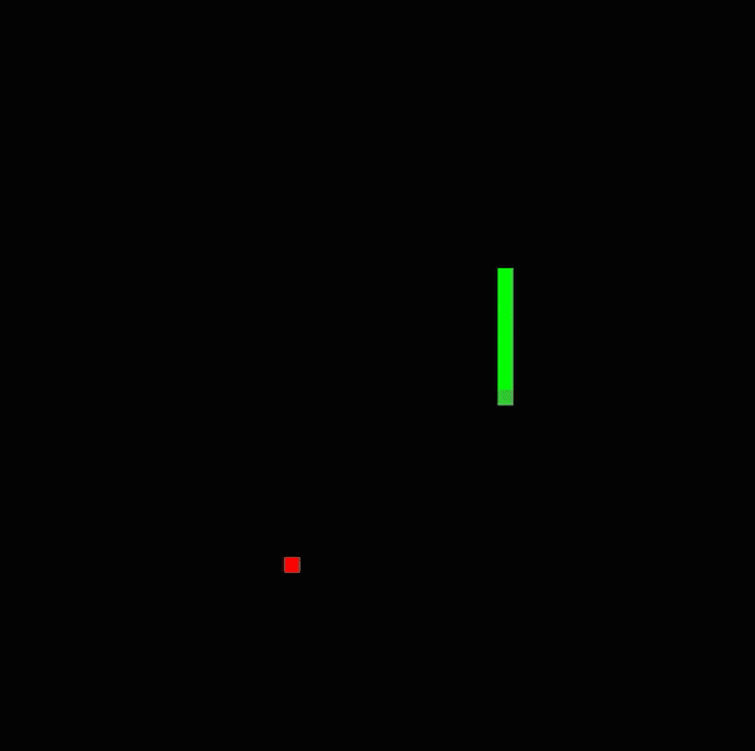
Demo

Slide 10
Thank You!!!!!!

